Slide 1
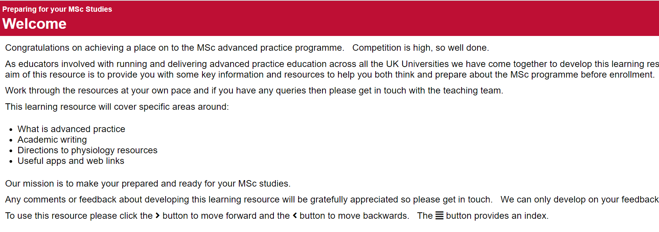
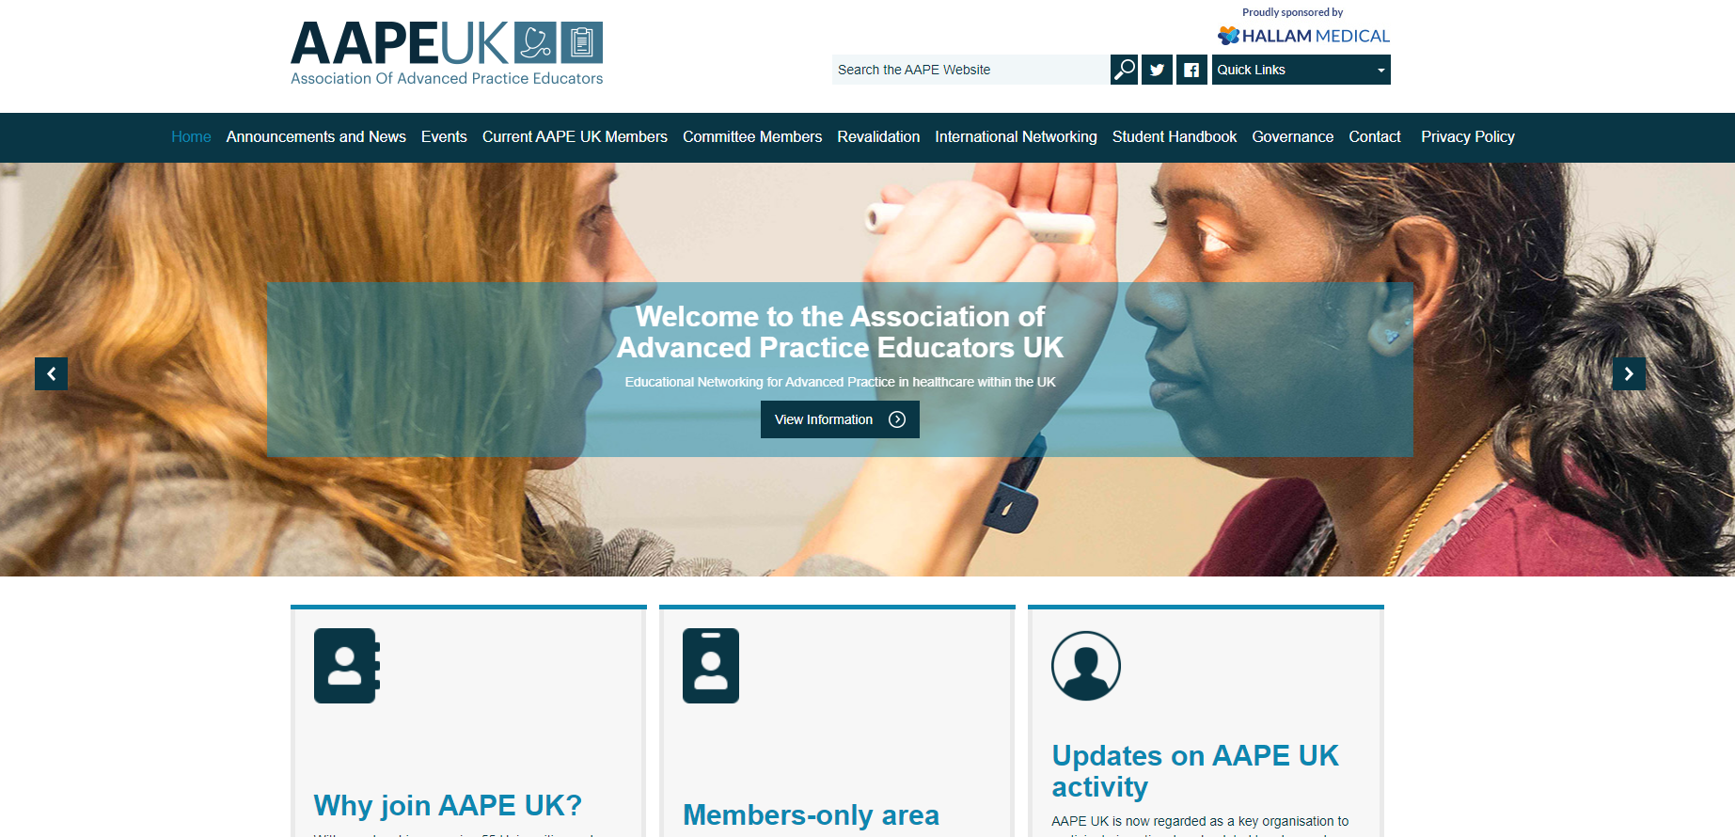
Development of a UK Pre-Course Workbook for Advanced Practice Students Colette Henderson, University of Dundee, Dr Anna Jones Cardiff University, Jonathan Thomas Swansea University, Professor Melanie Rogers and Emma Fawcett University of Huddersfield and Danielle Pinnock The Royal Marsden School
Outcomes
Background
An evaluation is currently in progress and outcomes will be reported when available.
This collaboration enabled faculty across the UK to work together and develop a UK wide resource. This method supports robust, proactive and aligned approaches to the development of advanced practice student resources.
Positive outcomes include agreement across the UK in terms of requirements and shared workload. This virtual collaboration has supported effective and efficient development of a UK wide resource and has led to agreement for future collaborations.
The UK have taken a unique approach towards multidisciplinary advanced practice development across the four countries (Health Education England (HEE) 2017, Department of Health (DoH) 2019, Welsh Government (WG) 2020 and SG 2021).
Demand for multi-professional advanced practitioners has intensified and this is evident through increased applications to programmes and advertised jobs.
The Association of Advanced Practice Educators (AAPE UK) were approached by University of Huddersfield Advanced Practice faculty and asked to invite Advanced Practice Educators to collaborate on development of a pre-Advanced Practice course workbook.
Through AAPE UK, a number of educators from higher education institutions across the United Kingdom collectively agreed a need for trainee advanced practitioner student support. Development of a pre-course workbook would support students undertaking programmes of education. It was felt this workbook should focus on areas of concern such as contextual understanding of advanced practice, anatomy and physiology knowledge and critical writing skills.
Student Comments:
Just had a quick look through - what a fantastic resource!
I have been completing the pre course workbook this morning and found it really helpful.
Method
Faculty from the four countries of the United Kingdom collaborated virtually to agree content and assign roles to develop agreed content. These meetings and associated email communications enabled the development of the workbook. To encourage knowledge of and engagement with AAPE UK, the workbook is currently hosted on the AAPE UK website.
References
Health Education England (2017) Multi-professional framework for advanced clinical practice in England. Available at: https://www.hee.nhs.uk/sites/default/files/documents/multiprofessionalframeworkforadvancedclinicalpracticeinengland.pdf (Accessed 28.03.2022).
Department of Health (2019) Advanced AHP Framework. Available at: https://www.health-ni.gov.uk/publications/advanced-ahp-practice-framework (Accessed 28.03.2022).
Scottish Government (2021) Transforming Nursing Roles Paper 7 Advanced Nursing Practice - Phase 11 Available at: https://www.gov.scot/publications/transforming-nursing-roles-advanced-nursing-practice-phase-ii/ (Accessed 28.03.2022).
Welsh Government (2020) Allied Health Professions Framework for Wales: looking forward together Available at: https://gov.wales/allied-health-professions-ahp-framework (Accessed 28.03.2022).

