Slide 1
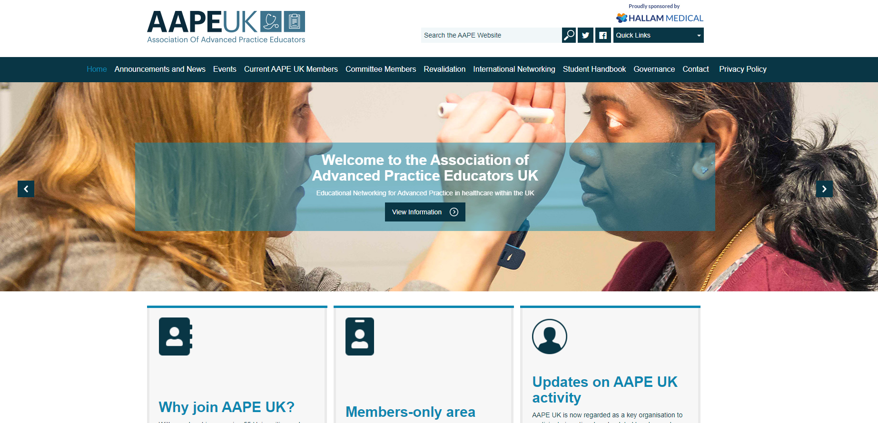
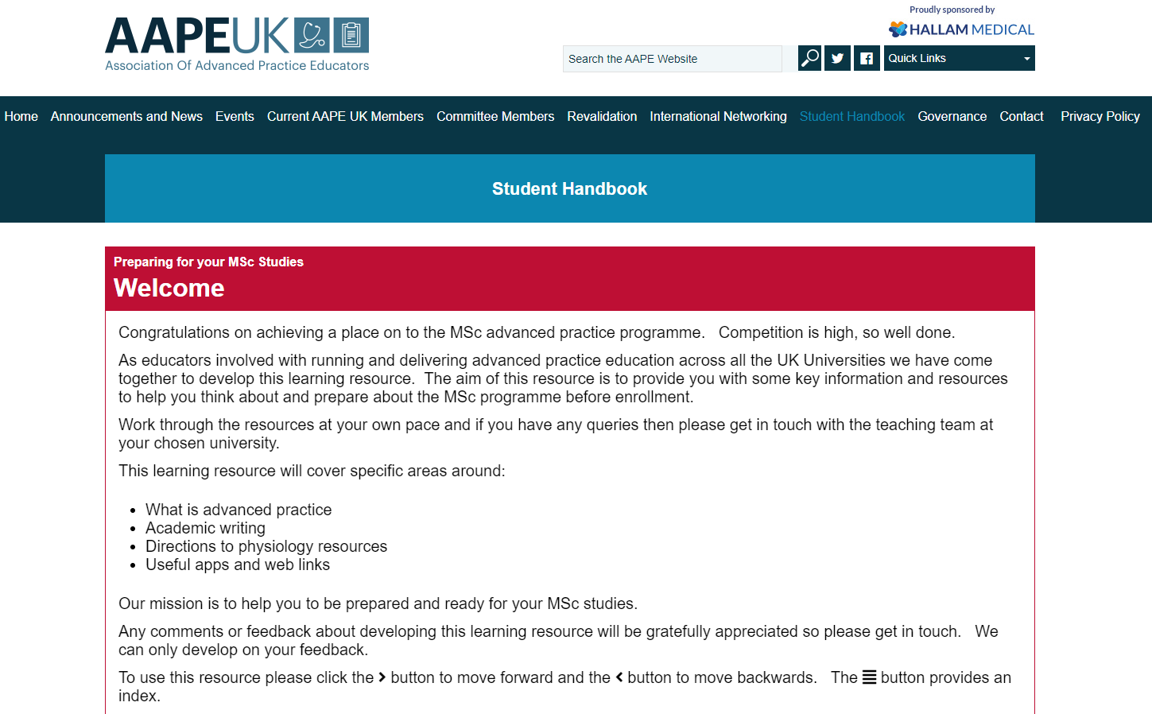
Developing a Pre-Course Workbook for Advanced Practice Students in the United Kingdom Colette Henderson, University of Dundee, Dr Anna Jones, Cardiff University, Jonathan Thomas Swansea University, Professor Melanie Rogers, University of Huddersfield, Angie Banks, Sheffield Hallam University
Background
In 2021 a small group of advanced practice educators from higher education institutions across the United Kingdom collectively identified the need for trainee advanced practitioner student support. It was agreed that this support should commence prior to students undertaking programmes of education.
Faculty involved in developing this pre-course support had individually and collectively identified issues with advanced practice students having contextual understanding of advanced practice within the UK along with challenges developing anatomy and physiology knowledge and critical writing skills. Reynolds and Mortimore (2021) concur that academic study can be challenging for some students transitioning into advanced practice roles.
Purpose
The project group aimed to develop a pre-course workbook which would support students commencing Advanced Practice programmes and focus specifically on the areas identified above. Development of critical thinking is key to both MSc level education and advanced practice (QAA 2020 and Taylor and Littleton-Kearney 2011).
Approach
Faculty from the four countries of the United Kingdom were invited to join the project through the Association of Advanced Practice Educators UK (AAPE UK). Faculty from 15 Universities met virtually on four occasions to agree content and assign roles. The development of the workbook was achieved through these meetings and associated email communications. To encourage knowledge of and engagement with AAPE UK, the workbook is currently held on the AAPE UK website (images opposite).
Key Learning
An evaluation is currently in progress and outcomes will be reported when available.
This project enabled faculty members to collaborate on the development of a UK wide resource. This method supports robust, proactive and aligned approaches to the development of advanced practice student resources. It was encouraging to have strong agreement across the UK faculty involved, and a collaborative project group ensured the workload was shared. Remote/virtual working supported effective and efficient development of this resource and has resulted in additional networking and collaborative projects.
References
Reynold J, Mortimore G. (2021) Transitioning to an ACP: a challenging journey with tribulations and rewards British Journal of Nursing 30,3,166.
Quality Assurance Agency (2020) Characteristics Statement Master’s Degree Available from: Characteristics Statement: Master's Degree (qaa.ac.uk) (Accessed 09.10.2022)
Taylor, L.A., and Littleton-Kearney, M. (2011) Concept Mapping A Distinctive Educational Approach to Foster Critical Thinking Nurse Educator 36, 2, 84-88.
For further information please contact:
c.m.j.henderson@dundee.ac.uk
Twitter:@coletteh16

