Slide 1
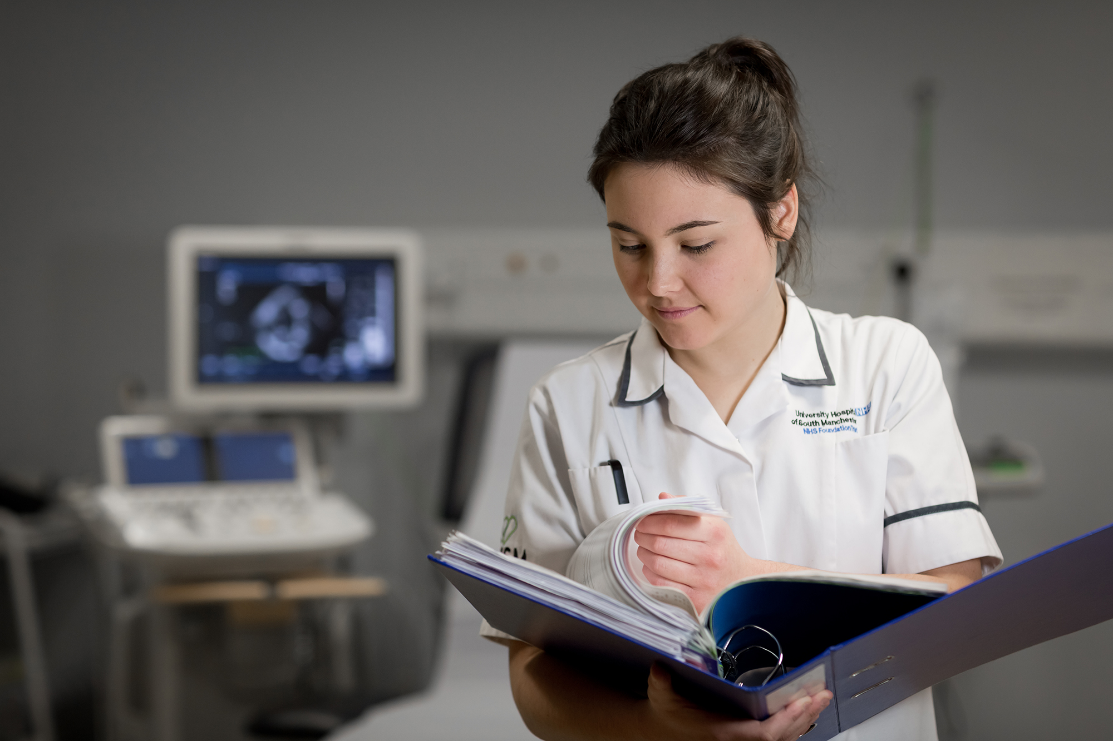
Aspiring Advanced Clinical Practitioners
Programme
Melanie Rogers, Angie Banks, Colette Henderson,
Anna Jones, Jonathan Thomas
3533
Notes:
MR
1.5 minutes per slide.
AJ to share
AJ to move on slides

Slide 2
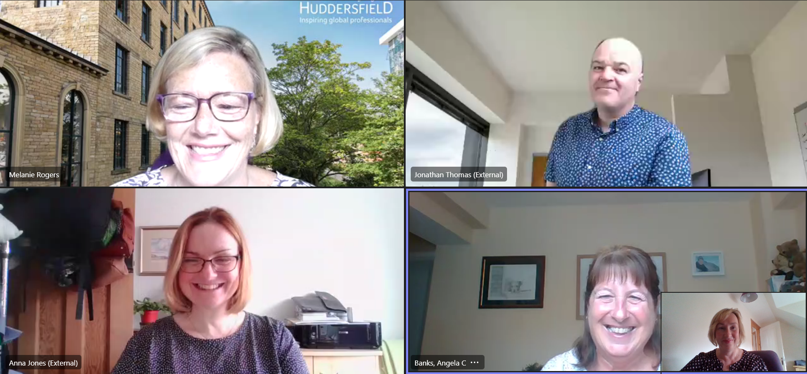
Introductions to the Team
Notes:
Introduce selves

Slide 3
Background:
2021- Small group of Advanced Practice educators from Higher Education Institutions across the United Kingdom collectively identified the need for trainee Advanced Practitioner student support prior to starting an MSc.
Jan-July 2021- Development of a pre-course workbook, followed by soft launch and evaluation of the pilot workbook. Final workbook launched in Autumn 2021.
Workbook: https://aape.org.uk/huuiuydcqrgccgndfa3qudehz/
January 22- Aspiring ACP’s collaborative initiative between the University of Huddersfield & Sheffield Hallam University.
July & August 22- Two day Aspiring ACP programme –Free to all Yorkshire & Humber regional trainees starting their MSc.
Notes:
AJ – first two points
Angie – second two points

Slide 4
First Steps:
Team of 15 educators from across the UK
Met over period of 6 months
Discussed and debated trainee needs
Asked small group of ACP/APs what they wish they had known before starting their course
Focused on 4 key areas with working groups developing resources
Published first draft Autumn 2021
Evaluations identified some additional areas to develop
Changes made to workbook
Overwhelming positive feedback for workbook across 4 countries
Notes:
AJ and JT
AJ first 4 boxes
JT rest of boxes

Slide 5
Over to you!
What do you think Advanced Practitioner trainees need to know before starting on their MSc?
Notes:
Put into chat – out to delegates = - AJ and JT
MR and AB to monitor chat

Slide 6
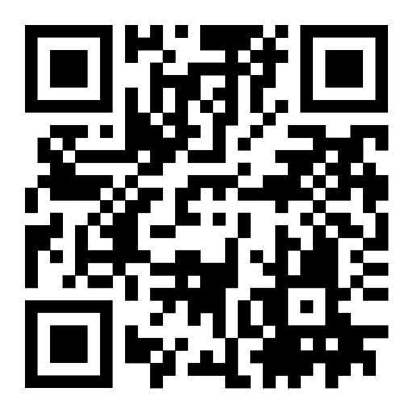
Workbook Content: https://aape.org.uk/huuiuydcqrgccgndfa3qudehz/
Contextual understanding of Advanced Practice development in the UK
Anatomy and physiology knowledge
Critical analysis skill
Useful apps
Notes:
JT

Slide 7
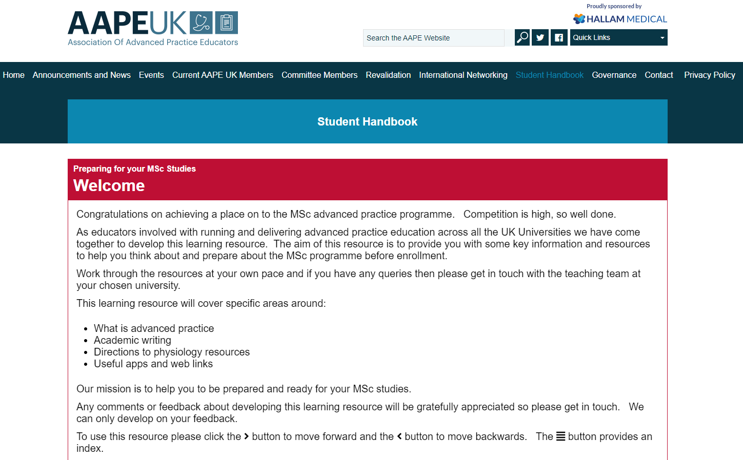
Notes:
JT

Slide 8
Significance, Impact and Reach:
UK wide
Robust collaboration across all four countries
Created from trainee feedback
Multi-Disciplinary
Open to all trainees in any HEI’s not just AAPE members
Introduces students to AAPE
Prepares students for starting their MSc
Sets level of expectation for education and training
Other countries looking to develop similar resources
Notes:
AJ

Slide 9
Coming up!
Demystifying Advanced Practice
Join us and develop your own Aspiring ACP programmes
Presentations around the world- Dublin, Montreal
Come to Aberdeen
Join AAPE
Notes:
JT/ AJ

Slide 10
Over to you!
Now you have heard from us how could we develop the workbook further?
Notes:
Chat…delegates

Slide 11
Aspiring Advanced Clinical Practitioners
Programme
Professor Melanie Rogers & Angie Banks
Notes:
Mel

Slide 12
What we did:
Regional approach- invitations sent out via regional HEE
HEI’s- invitation sent out with confirmation of place on a MSc ACP programme
Pre-course study days held at two of the regions HEI’s
Notes:
Mel

Slide 13
Aspiring ACP programme covers the follow topics:
Studying at level 7 and the required skills for academic writing
Demystifying the role of an ACP, both in training and on qualification
Understanding and developing knowledge of anatomy and physiology that is relevant for ACP studies
Preparatory tool kits and e-resources that are useful
Preparing as a trainee and supporting your organisation to be an ACP trainer
The role of the e-portfolio
The opportunity to meet other prospective students and gain top-tips from current students from across the region.
The opportunity to access and complete the national trainee ACP workbook
Notes:
Mel

Slide 14
Day 1- July 26th
Time | Section | Activity | Team
10:15-11:15 | Introductions and welcome | Icebreaker | Team
11:15-12:15 | Introduction to regional, national and international perspectives of the Advanced Clinical Practice Role |  | Julie Perrin & Linda Croft (HEE Regional Leads) Angie Banks and Angela Windle (National) Melanie Rogers (International)
12:15-13:00 | Lunch (provided)
13:00-14:00 | Introduction to the trainee ACP workbook | Access to workbook Online activity | Melanie Rogers (Professor Advanced Practice) Angie Banks (Course Leader)
14:00-15:00 | Introduction to academic writing |  | Angela Windle (Course Leader) Jane Anderson (ACP/HEI) and Liz Drain (ACP/HEI)
15:00-15:15 | Q&A |  | Team
Notes:
Mel

Slide 15
Day 2- 31st August
Time | Section | Activity | Team
1100-1110 | Intro |  | Mel & Angie
11:00 -11:30 | Introduction to Professional leads Role & the Community of Practice |  | Sarah Fisher (HEE) Suzanne Owens webinar (ACP)
11:30-12:00 | Introduction to Hee Supervision & assessment Leads | Supervision & Casp | Sadie Diamond Fox/Kirsty Laing (HEE Regional Supervision Leads)
13:00-13:50 | Understanding the role of the trainee ACP role and how to get going, ensuring you have the right placement. Diversity of Roles- PowerPoint | Students’ top tips | Helen Keating (Neurosurgery ACP) Melanie Clarkson (Radiotherapy ACP) Martin Longden (Paramedic ACP) Helen Davison (ACP Lecturer SHU) Claire Manderson- (Physiotherapy ACP trainee) Jonathon Drury- (Orthoptist ACP trainee)
13:50-14:15 | Advanced Practice & Mental Health Importance Mental for All practitioners- |  | Helen Jennings (Mental Health ACP Route Leader)
1415- 14:45- | Preparation, opportunities, and support for the Trainee ACPs (including E-Portfolio Developments) Apprenticeship |  | Angie Banks (E-Portfolio) Melanie Clarkson Tim Butterill (HEI)
14:20-15:00 | Reflections and Update on Workbook Learning | Small groups | Angie Banks, Mel Rogers,
15:00-15:15 | Conclusion and Evaluation
Notes:
Angie

Slide 16
Attendance day 1&2
- 100 attendees(day 1) 65 (day2) from a diverse regional spread
Acceptance on a variety of HEI programmes
Diverse Professional backgrounds
MSc ACP programmes- apprenticeship & non- apprenticeship
Representation from HEE, ,Reginal faculties, HEI’s lecturers, ACP and current trainee ACPs
Notes:
Angie

Slide 17
What would you want from an Aspiring ACP day?
Over to you!
Notes:
Chat – all to monitor

Slide 18
Comments – on twitter
Thanks for today looking forward to starting my ACP journey
Thanks to all contributors for the aspiring ACP sessions. Really enjoyed them & looking forward to the course. Fantastic to hear there's lots of support out there #acp
Credit to the AP teams at these HEI’s, its a fantastic initiative that has seen some very positive feedback that I've seen via social media after day 1. Today is day 2
@EsD
Notes:
Angie

Slide 19
Evaluations-completed on Day 2 Key points- questions asked and exemplars of replies
Total Completed 55 out of 65 attendees at end of Day 2
What was good about the programme?
Good insight into course and expectations.
Inspiring and motivating.
Fab resources,
apps, guidelines and frameworks.
What else could have been included?
Portfolio examples.
Representation from all HEI’s
How did you feel about the trainee ACP role before attending the course?
Anxious.
Not very well informed.
Terrified
What support do you feel you still need before starting your ACP training
Placement advice.
End point assessment information.
Notes:
Angie

Slide 20
Did your thoughts feelings change after attending the Aspiring programme?-
“This will be hard but let’s grab it by both hands”
“More aware of external support”
“More aware of external support”
“More aware of external support”
“
“I feel so much happier, it’s eased my stress and anxieties”.
“I’m excited now to start”
“I’m excited now to start”
“I’m excited now to start”
“I’m excited now to start”
“It all feels much clearer”
“Confirmed this is the right step for me”
“It all feels much clearer”
“It all feels much clearer”
“Feel more confident to be assertive about prioritising my own learning needs”
“Feel more confident to be assertive about prioritising my own learning needs”
“Feel more confident to be assertive about prioritising my own learning needs”
“Feel more confident to be assertive about prioritising my own learning needs”
“yes, I have more understanding of the programme”
“yes, I have more understanding of the programme”
“I feel much more prepared”
“I feel much more prepared”
“I feel much more prepared”
“Can we have another day all together in 2023”
“Can we have another day all together in 2023”
“Can we have another day all together in 2023”
Notes:
Angie

Slide 21
General Comments
“Overall enjoyed the days, very informative and would recommend”
“Excellent faculty at both locations, fabulous to see cross uni networking”
“Would be good to come together annually to discuss pressure/experiences”
Notes:
Angie

Slide 22
Final Thoughts:
Notes:
Mel

Slide 23
Thank you for Listening!
Notes:
All of us

