Slide 1
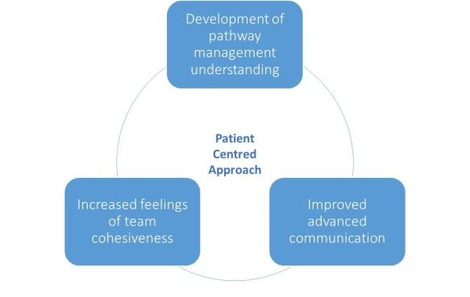
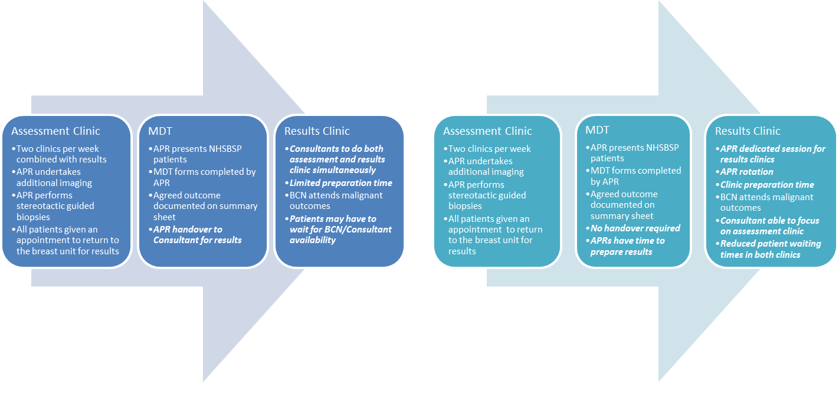
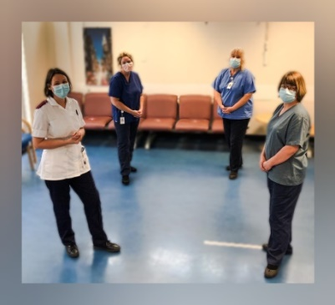
Leadership in Advanced Practice:
Evaluation of Radiographers Delivering Breast Screening Results
Joleen Kirsty Eden - Consultant Radiographer
Background
Advanced practitioner Radiographers (APRs) at ELHT are the first to implement a fully radiographer led results service for breast screening patients
Aim
To evaluate the impact of APRs delivering breast biopsy results on the local breast imaging service one year post implementation
Method & Data Collection
Survey design distributed to breast unit staff; APRs, radiographers, clinical assistants, assistant practitioners, breast care nurses, breast imaging manager, breast operations lead, screening officer, consultant radiologists and consultant radiographer
Themes
Clinical efficiency, team cohesion and improved professional development were identified as core themes
Training priorities were taken from an exploratory study (fig 1).¹
Workflow changed following implementation (fig 2)
Identify common themes from the evaluation
Overall response rate of 63.3%
Discussion
Response rate attributed to acute covid-19 pandemic phase
Conclusion
Responses highlighted significant role development with patient-centred care , improved efficiency of the assessment clinics and overall increased satisfaction throughout the breast team
Impact on Profession
Implications for practice to be adopted by other breast units
An increase in efficiency, performance and patient satisfaction were reported due to improved workflow
The core themes created a self-perpetuating cycle (fig 3)
National shortage of Radiologists highlights requirement for furthering advanced practice
May address radiographer recruitment and retention challenges
Training priorities enabled successful implementation
Advanced Communication Training
(Accredited)
Observations
- Variety of clinicians and pathways
Communication Strategies
- Workshop
Environment for Result Clinics
De-brief
Local Protocol Development
Communicating results to GP/Surgeon
Dictation training
Figure 1: Training priorities
Figure 2: Workflow changes
Clinical
Efficiency
Figure 3: Theme Cycle
1. Eden, JK. & Borgen, R. The British Journal of Radiology. BJR, 2020.

Slide 2
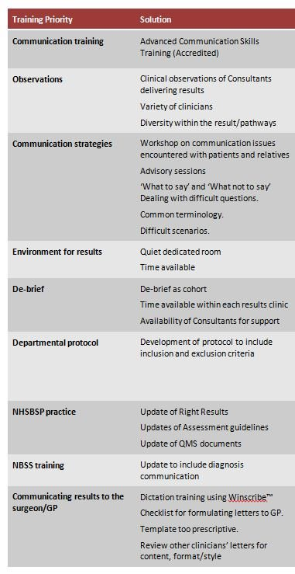
Advanced Communication Training
(Accredited)
Observations
- Variety of clinicians and pathways
Communication Strategies
- Workshop
Environment for Result Clinics
De-brief
Local Protocol Development
Communicating results to GP/Surgeon
Dictation training

